Slide 1


A BETTER WAY TO TAKE CARE OF BUSINESS
WORKFORCE HEALTH | RESOURCES
Protecting Your Employees from the Pandemic
Lessons from the Field

Slide 2
For Today’s Discussion
A BETTER WAY TO TAKE CARE OF BUSINESS
COVID-19 Review
Mental Health & Wellness
“Social Health”
Resources
Discussion

Slide 3
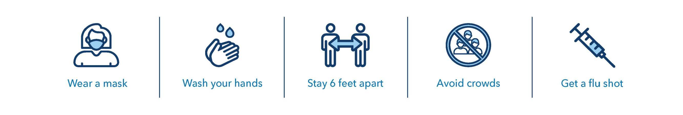
Bend the COVID Surge Curve
A BETTER WAY TO TAKE CARE OF BUSINESS
Hawaii has only had two waves while many parts of the mainland are on its third way.
Residents have an opportunity to change the trend by adopting easy-to-do behaviors
Notes:
As we look at safety measures with COVID-19, Let’s start of by where we are right now in Hawaii. We are on the 2nd wave however, many parts on the mainland is on their 3rd wave. This tells us a lot about how we are doing in Hawaii in taking safety measures and precautions. Which is a true testament of the improvement we are making within our state. We are known as having multi-general households and as we continue on this journey fighting COVID-19, just a reminder of the great work that we are doing to keep ourselves, our family, and our communities safe putting healthy practices and what we are already doing…wearing a mask, hand washing, 6 feet distancing, avoid crowds, and get your flu shot if you haven’t done so already.

Slide 4



Assessing safety when returning to work
A BETTER WAY TO TAKE CARE OF BUSINESS
As you plan employees’ return to the workplace, consider the levels of employee health risk.
Risk mitigation strategies
Health care workers
Practice physical distancing
Minimize shared objects
Limit in-person gatherings
Limit travel
Promote and support sanitation/hygiene measures
Align company policies to support mitigation
Develop and communicate containment protocols
Very
High
Workers in close contact with the public
Medium High
Roles in contact with the public
Medium
Jobs that require minimal contact
Low (Caution)
Source: OSHA.
Notes:
According to OSHA – There are risk levels based on the line of work that individuals. Which can put you at greater risk of COVID-19 exposure. Taking into consideration the safety precautions we discussed in previous slides, somethings to think about in addition for your worksite or workplace
Minimize sharing of objects.
Limit travel for those that require to travel from different worksites or to different islands.
Promote and support sanitization/hygiene measures in the workplace
Revisit and align company policies to support mitigation
Communication is truly key to develop and communicate protocols.

Slide 5

Return-to-work timelines for people with COVID-19
symptoms or exposure
A BETTER WAY TO TAKE CARE OF BUSINESS
Individuals with symptoms* Individuals without symptoms
Employees who have tested positive and have experienced symptoms can return to work:
>1 day from recovery
or
>10 days from symptom onset
Employees who tested positive without symptoms can return to work:
>10 days since first positive test
Employees who have had exposure to COVID-19, but haven't tested positive or experienced symptoms, can return to work:
>14 days since last exposure, even after a negative test**
For more information on workplace guidance, visit: https://hawaiicovid19.com/workplace-guidance/
*A test-based strategy is no longer recommended to determine when to discontinue home isolation, except in certain circumstances.
**Based on local recommendations, the CDC is also allowing some health departments to choose a 10-day quarantine time or a 7-day quarantine time with a negative test. Check with your local officials for the latest guidance.
Sources: Duration of Isolation and Precautions for Adults With COVID-19, October 19, 2020; Ending Home Isolation for Persons With COVID-19
Not in Healthcare Settings, December 3, 2020; Return-to-Work Criteria for Healthcare Personnel With SARS-CoV-2 Infection, August 10, 2020; When to Quarantine, December 2, 2020.
Notes:
Department of state of Department of Health website. As specific return-to-work may vary from island to island and changes may occur frequently. Stay up to date with the latest return to work by checking the DOH website.
Individuals with symptoms - 10 days after onset of symptoms or day after from recovery
Individuals who tested positive – can return to work after10 days since first positive test
Individuals without symptoms, who tested positive but are without symptoms can return to work
10 days since first positive test
Employees who have had exposure to COVID-19 but haven’t tested positive or experienced symptoms, can return to work:
- 14 days since last exposure, even after negative test.

Slide 6

For more clinical info on COVID
A BETTER WAY TO TAKE CARE OF BUSINESS
Webinar: COVID-19 update #13 – Vaccine Update
  Dr. Deb Friesen will speak about the scientific realities of coronaviruses and COVID-19, control measures, and Kaiser Permanente’s response on Thursday, December 17, 1 – 2:00 p.m.
  Register here: https://kponline.webex.com/kponline/onstage/g.php?MTID=e978829e7f0def63be6aa240a1d1d9e8e
  You’ll learn about:
    COVID-19 updates and trends — Insights on the current state of the pandemic, including treatment and testing
    Emerging vaccine developments — Relevant information regarding the development, FDA review, and distribution of recently approved COVID-19 vaccines
Notes:
For the most current clinical updates, trends on COVID-19 and vaccines, we would like to invite you to Kaiser Permanente’s Webinar tomorrow at 1 pm. Our presenter is our Kaiser Permanente physician – Dr. Deb Friesen and One of our Sr. Directors David Tumilowicz.

Slide 7
A BETTER WAY TO TAKE CARE OF BUSINESS
Communicate health and safety guidelines clearly and frequently
Percent who report they believe COVID info from each source
Strategies for communicating could include a campaign focused on:
Hand hygiene, physical distancing, and mask-wearing to stop the spread of COVID-19 and other illnesses
The importance of getting a flu shot, especially during the
COVID-19 pandemic
What employees should do if they or a coworker have COVID-19 symptoms.
A centralized COVID -19 website or resource to house up-to-date workplace procedures and policies
How to access health care when they need it, be it COVID-19-related or otherwise
Source: https://www.edelman.com/sites/g/files/aatuss191/files/2020-03/2020%20Edelman%20Trust%20Barometer%20Coronavirus%20Special%20Report_0.pdf
Notes:
Other safety measures:
Assign or identify a workplace coordinator to keep track of COVID-19 issues that impact the workplace. Coordinator to also track suspected and confirmed cases among workers. - Develop testing strategy, work with local health department in contact tracing and quarantining of close contact, consider whether to temporarily suspend operations.
Prepare for business continuity plans for significant abesenteesm, supply chain disruption, or changes in the way you may need to do business.
Communicate any policies for telework and leave policies to allow employees to stay home to care for sick family members or care for children if school and childcare are closed.
Minimize face to face contact – example meetings to be done remotely if possible. Use staggered work shifts and promote teleworking when possible.
Share your response plan with employees and clearly communicate expectations. It is important to let employees know the plans and expectations if COVID-19 Occurs in the communities where you have a workplace or site.
Limit travel.

Slide 8


Customer Story
A BETTER WAY TO TAKE CARE OF BUSINESS
Identify a workplace coordinator to keep track of COVID-19 issues that impact the workplace.
Company scheduled organizational meeting with staff on a frequency basis to provide updates (including most current CDC guidelines, policy changes etc.).
Scheduled team meetings and check-ins
Use multiple platforms to communicate COVID-19 information and well-being topics. (Teams, Zoom, Text messaging, email, intranet)
Shared and reminded employees on benefits such as EAP, Health plan benefits, financial support, community resources. How to access care etc.
Sharing of information and creating a section for wellness in a section on the company intranet.
Health plans also provided ways they can access care and resources while during COVID
Employer built a communication campaign that focuses on topics each quarter.
Notes:
Communicate any policies for telework and leave policies to allow employees to stay home to care for sick family members or care for children if school and childcare are closed.
Minimize face to face contact – example meetings to be done remotely if possible. Use staggered work shifts and promote teleworking when possible.
Limit travel.

Slide 9
Help your team manage pandemic-related fear and anxiety
A BETTER WAY TO TAKE CARE OF BUSINESS
Fear and anxiety are manageable with clinical support.
Telehealth and online mental
healthcare resources:
24/7 advice
Video visits
Phone appointments
Online resources available through kp.org
Notes:
Multiple resources suggest that the use of telehealth services for mental health conditions might reduce COVID-19-related mental health consequences.^{1,2,3} Online cognitive-behavioral therapies have been successful in the treatment of anxiety.^{2,3}
Kaiser Permanente offers both primary and specialty care via telehealth. No referral is needed for members to access mental health support, and there are numerous options available for accessing:
24/7 advice
Video visit
Phone appointment
Email
E-visit
Online self-care
Mobile app and kp.org
Whenever possible, employers can help support employee mental health by promoting social connectedness, supporting persons at risk for suicide, addressing stress from experienced racial discrimination, and promoting of health services related to emotional well-being. To reduce potential harms of increased substance use related to COVID-19, resources, including social support, comprehensive treatment options, and harm reduction services, are essential and should remain accessible.¹
______
¹https://www.cdc.gov/mmwr/volumes/69/wr/mm6932a1.htm
²https://www.sciencedirect.com/science/article/pii/S016517812030740X
³https://journals.sagepub.com/doi/full/10.1177/0030222820949350

Slide 10




A BETTER WAY TO TAKE CARE OF BUSINESS
Planning for the “next normal”
Offer and promote available resources
Ensure access to robust mental health services
Promote and optimize EAP services
Provide self-care tools for resilience
Notes:
Make sure employees know how to engage in the mental health care offered by their health plan.
Communicate what is offered and remind employees that their participation is confidential (a common misunderstanding of EAP services), including work-life services, leverage
Promote the use
of emotional well-being resources available through your employer health and wellness partners. support for managers, and consider expanding the number of EAP sessions or temporarily providing on-site EAP services.

Slide 11






A BETTER WAY TO TAKE CARE OF BUSINESS
Planning for the “next normal”(continued)
Build or reinforce a psychologically healthy workplace
Awareness of mental health and resources
Reduce stigma for mental health
Address workplace bullying and discrimination.
Strengthen your workforce health strategy
Promote a sense of purpose.
Provide managers with training for the current situation
Notes:
Our FindYourWords public health campaign has tools for members and non-members.
Stress may exacerbate workforce tensions, political differences, racial discrimination, and differing perspectives about returning to work
Offer programs addressing exercise, nutrition, smoking session, sleep, stress, etc.
Shared meaning builds strong connections. Helping employees to find meaning in their work and understand the mission of your organization can help them feel more connected and protect them against the harmful effects of loneliness.
Provide managers with training, resources, and support to address workplace mental health and well-being.

Slide 12
Customer Story – MHW
A BETTER WAY TO TAKE CARE OF BUSINESS
Employer HR and leadership revisited company policies and procedures to include safety and precautionary measure for employees
EAP – reinforcing the EAP benefits that employees have available.
Implementing a wellness program that focuses on overall health and well-being. Focusing on a well-being topic each month or quarter. Example: Emotional health, stress management, etc.
Ongoing communication on resources available that is provided by the health plans and community resources.
Quarterly webinars provided by the employer to focus on relevant topics that will help employees during challenging times.
Formation of social groups in the workforce based on common interest or check-in groups.

Slide 13


Kaiser Permanente’s Approach
A BETTER WAY TO TAKE CARE OF BUSINESS
13
Notes:
Lead speaker: Alaya
Kaiser Permanente’s mission is to provide high-quality, affordable health care services and to improve the health of our 12.3 million members and the 68 million people who live in the communities we serve.
Social health is a key component of total health
You may be aware of the physical and mental health care we provide, but now I want to talk about social health — something that’s inextricably connected to how we approach our mission:
Social health is the combination of social drivers that impact a person’s total health. These drivers can exist at the individual, local, and societal level.
For example, a person’s access to basic nutrition, a place to live, and economic opportunities are all factors that contribute to his or her social health.
People’s physical, mental, and social health are interconnected. If any one of these suffers, it can affect the other aspects of total health.

Slide 14
A BETTER WAY TO TAKE CARE OF BUSINESS
What drives health outcomes?
What percentage of an individual’s overall health outcome is attributable to clinical care?
5%
20%
40%
80%
14
Notes:
Lead speaker: Tom

Slide 15













A BETTER WAY TO TAKE CARE OF BUSINESS
Social drivers of health account for ~40% of health outcomes
The social drivers of health are the conditions in which people live, work, and play.
Social and economic factors include access to basic nutrition, a place to live, and economic opportunities all play a role in health.¹
10%
Physical
environment
20%
Health
care
30%
Health
behaviors
40%
Socioeconomic factors
Source: University of Wisconsin, County Health Ranking Model, 2018.
1. Also known as basic human needs.
Notes:
Mention Thrive Local here.
Health care = access to care
Health behaviors = alcohol use, sexual activity, tobacco, diet, exercise
Socioeconomic factors = education, job status, family support, income, community safety

Slide 16
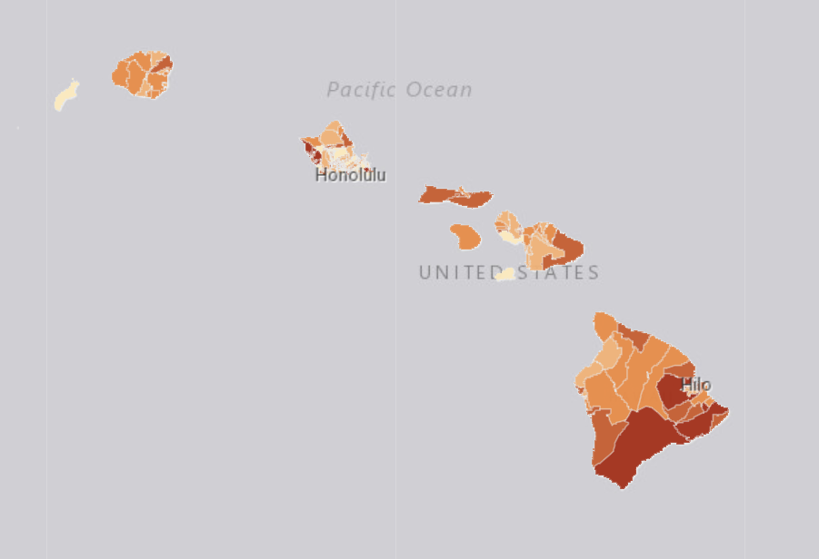
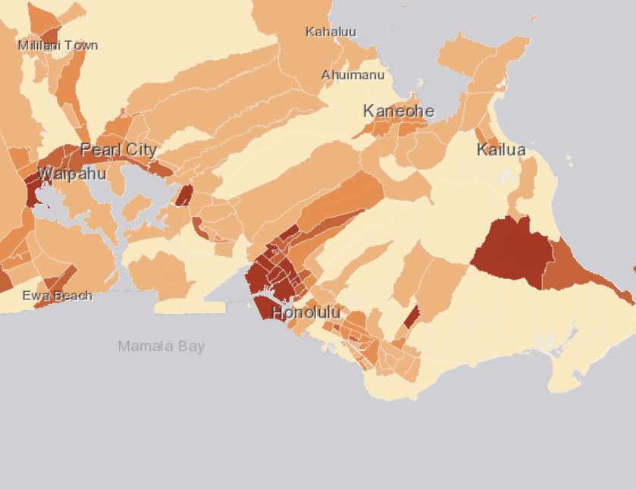
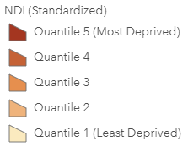
Hawaii Heat Map
A BETTER WAY TO TAKE CARE OF BUSINESS
Using NDI, each census tract is assigned one of five levels. Level 1 indicates the least deprived (i.e. most well-off by education, income, housing and employment standards), and Level 5 indicates the most deprived.
Notes:
The NDI is a standardized measure that capitalizes on readily available U.S. Census data. To calculate the measure, eight variables are run through a principal component analysis to arrive at standardized scores, which can be used directly or grouped into quintiles — levels — for mapping and analysis, where the lowest is the least deprived group. This measure will be updated annually when new American Community Survey data become available and included in the GEMS datamart.
This slide and the other slides with heat maps show where your group is headquartered — not where your group’s employees live.
If your group covers 1 region, you’ll have 3 heat maps: a regional snapshot and 2 close-ups based on your group's headquartered address. For example, for an Oakland-based company, the 3 heat maps provided will be of: Northern California (regional view), the Greater Bay Area, and a close-up of downtown Oakland.
If your group covers more than 1 region, for each region you'll have a regional snapshot and 1 close-up heat map. If your group is in 2 regions, you’ll have 4 slides of heat maps.

Slide 17
Social Health: Social Drivers vs. Social Needs
A BETTER WAY TO TAKE CARE OF BUSINESS
Drivers
Economic Stability & Opportunity
Education
Social and Community Context
Neighborhood & Built Environment
Healthcare System
Needs
Living Wage
Payment rent/mortgage & Utilities
Affordable Food
Reliable Transportation
Personal Safety
Community conditions that
drive health
Resources people need to meet everyday demands of life
Social Drivers of Health
Continuing Education Class
December 9, 2020
Notes:
Lead speaker: Alaya
Transition: before showing next slide, Tom will ask attendees to write on a piece of paper their guess as to what percentage of the US has trouble meeting one social need . . .

Slide 18
Social Needs Prevalence
A BETTER WAY TO TAKE CARE OF BUSINESS
68% of Americans have trouble meeting at least one social need such as food, financial strain, housing or social isolation¹
38% of commercially insured individuals had at least one unmet need²
40% of Americans surveyed could not pay for an unexpected $400 expense³
1. 2019 Social Needs in America Survey, Kaiser Permanente
2. Berkowitz, S., et al., (2017). Addressing Unmet Basic Resource Needs as Part of Chronic Cardiometabolic Disease Management, JAMA Internal Medicine. 177(2):244-252.
3. 2018 Survey of Household Economics and Decision Making, US Federal Reserve
Social Drivers of Health
Continuing Education Class
December 9, 2020
Notes:
Lead speaker: Tom
When employers take action to address the conditions in which employees live and work, employees may:
Be physically healthier, leading to lower healthcare and workers compensation costs
Experience less stress due to challenges meeting basic, social needs
Be more productive at work due to fewer distractions with external stressors
Be more loyal to the employer, creating competitive advantage
Does connecting people to community-based services really impact health care costs? Yes.
A recent study by the Robert Wood Johnson Foundation found that when 33,000 people were referred to needed services at 106,000 community-based programs and services, it resulted in:
17% decrease in emergency department use
26% reduction in emergency care spending
53% decrease in inpatient spending
23% decrease in outpatient spending¹

Slide 19





Thrive Local: How KP Supports Community Health
A BETTER WAY TO TAKE CARE OF BUSINESS
Helping the communities where your employees work and live is part of our DNA
Inform through referral system
Identify social needs
Optimize data to inform social health ecosystem
Connect to community resources
By 2022, Thrive Local will be fully available to all Kaiser Permanente members and 68M people in our communities.
Notes:
Lead speaker: Alaya
Identification: Social needs are identified by Kaiser Permanente staff, clinicians, patients, caregivers, or community partners.
Connection: Using the Thrive Local network, health or social service providers can locate the community, government, or health care resources to meet social needs.
Information: Thrive Local provides information on community resources and tracks referrals with community partners.
Optimization: Data helps Kaiser Permanente and our community partners better understand social needs and social care gaps to improve community conditions for health.
Community health during the coronavirus pandemic²
COVID-19 affects entire communities and can’t be managed effectively by any single health care system. The pandemic has starkly highlighted disparities in income, food security, and technology access within communities. Vulnerable populations — including people who are immunocompromised, uninsured, and frail and elderly — are more susceptible to poor health care outcomes under the best of circumstances. In addition, some of these populations — people experiencing homelessness, incarcerated persons, and residents of assisted living and skilled nursing facilities — are living in situations that make them more vulnerable to disease spread.
Proactive, cross-sector support is critical for addressing these clinical and social drivers of health. Partnerships between health care systems and advocacy groups can help serve our most vulnerable populations. For example, Kaiser Permanente recently collaborated with the National Health Care for the Homeless Council to increase capacity for preventing and treating cases of COVID-19 within the nation’s homeless population.³
______
¹Social Determinants of Health: From Insights to Action, Genia, March 2019, p. 7. smartbrief.com/whitepapers/231404D2-91E3-4DDF-BEFE-A499A9635B92/Geneia_SDoH_White_Paper_2019.pdf.
²Stephen Parodi et al., “Kaiser Permanente’s System Capabilities to Suppress Covid-19,” Catalyst Innovations in Care Delivery, New England Journal of Medicine, June 9, 2020, catalyst.nejm.org/doi/pdf/10.1056/CAT.20.0187.
³“Supporting COVID-19 Response for U.S. Homeless Population,” Kaiser Permanente, March 15, 2020, about.kaiserpermanente.org/community-health/news/supporting-covid-19-response-for-u-s-homeless-population.

Slide 20
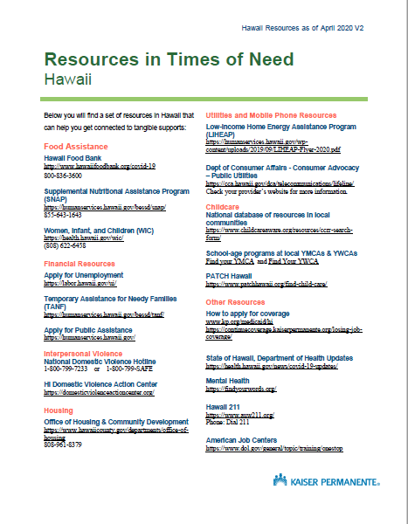
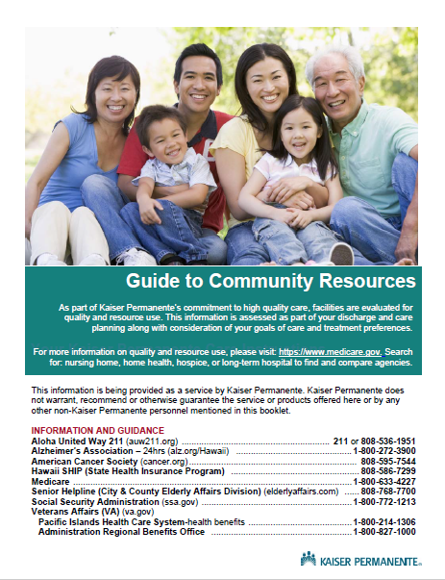
Community Resources
A BETTER WAY TO TAKE CARE OF BUSINESS
Notes:
Financial Support
Adult day care & Adult day health centers
Domestic violence help
Early Childhood Assistance
Emergency response systems
Financial resources
In-home assistance
Hospice agencies
Meals
Safety
Transportation

Slide 21

A BETTER WAY TO TAKE CARE OF BUSINESS
Gather insights into your
employee population
Anticipate and identify your employees’ potential social needs by looking into your demographic and utilization data.
Work with your business partners to identify the:
# requests for early paycheck release
# EAP utilizations and types of assistance needed
% of employees earning $25,000 or less (U.S Bureau of Labor Statistics).
% of employees who access their 401(k)/retirement funds early
Trends in requests for time-off, vacation days, or flexible work schedules
Types of unmet social needs your employees may share with wellness champions, their unions, employee resource groups; you can also survey them anonymously

Slide 22

COVID-19 Among the Filipino Community
A BETTER WAY TO TAKE CARE OF BUSINESS
The Filipino Community of Hawaii is disproportionally impacted by COVID-19
  16% of Hawaii’s Population
  21% of COVID-19 cases
  22% of COVID-19 deaths
Factors contributing to these disparities
  Higher number of essential and health care workers
  Higher occupancy in homes
  Education and use of PPE
  Higher rates of health disparities (impact survival and recovery)
Source: https://health.hawaii.gov/coronavirusdisease2019/what-you-should-know/current-situation-in-hawaii/#race
Notes:
Source: State of Hawaii, Department of Health Data. Data as of 12/7/20.
We were able to pull data specific to the Filipino Community in Hawaii as of 12/7/20.
The Filipino Community make up of 16% of the population. From the 16% - 21% (1) of COVID cases and 22% of COVID deaths. (1). Although percentage looks high, it is actually a small number.
Some of the factors that contribute to disparities include
Higher number of essential of health care workers in the filipino community
More occupancy in homes – Multigenerational household
Education on use of PPE. - considering language, age, etc.
Higher rates of health disparities – how can we together mitigate and ensure individuals are getting the care they need and managing their health well.
Filipino count summary:
Case Count: 2,651
Cases: 20%
State Population count: 222,369
State population %: 16%
Total deaths 58
Hospitalization: 226

Slide 23
Customer Story
A BETTER WAY TO TAKE CARE OF BUSINESS
Employer understood the need and support by conducting a survey in the workforce during COVID-19.
KP partnered with group and did a virtual presentation to the staff to talk about how to access care during the pandemic and available resources readily available at their fingertips. Example: Telehealth, wellness coaching, virtual offered class, etc.
Education around Mental Health and Wellness and how to get support and raise awareness of programs. Helped group to align resources based on challenges.
Community resources directory provided to employer to share with company or to enhance their booklet of resources to help employees navigate support during COVID-19 and challenges faces on top of life.
Promotion of KP programs that addresses the support around social determinants of health – example: pharmacy mail order, Class Pass to work out safely in their home, etc.
Notes:
Conduct toolbox talks on all job sites to explain the protective measures in place..
Revisit and revise company policies to include safety measurements and precautions.
Provide training or review of routine preventive safety measures
Implementing stickers to address areas of 6 ft distancing & signs of handwashing
Plexi glasses in common areas of contact.
Hand Sanitizers located in multiple locations in the workplace.
PPE mask readily available for staff.
Santizing work area after each use.
Administered onsite flu clinics at the worksite

Slide 24


A BETTER WAY TO TAKE CARE OF BUSINESS
Key Learnings
Consider policies and practices need to be created, maintained, or updated to create a safe and healthy workplace
Communicate often these policies and procedures
Promote physical and mental health resources
  Consider creating paid sick leave for employees with COVID-19
Strengthen your workforce health offerings
Better understand social health and factors impacting your employees
  Support employees’ childcare needs so they can come back to work
Additional resource: Coronavirus (COVID-19): Benefits Checklist — Business Group on Health
Notes:
Think about your Flexible Spending Account policies

Slide 25

A BETTER WAY TO TAKE CARE OF BUSINESS
Connect with and rely on
your partners
These teams will bring expertise to your specific needs, guide you as you consider various options, and be trusted thought partners. They will help you consider and implement business process changes where plans, policies, or
protocols are updated.
Legal counsel
Health and welfare benefit partners, including brokers
Cross-functional department leaders
Union leaders
Industry colleagues

Slide 26






A BETTER WAY TO TAKE CARE OF BUSINESS
How Kaiser Permanente can support you
Industry assessments
Webinars
Quality care and consultations
Thinking beyond physical health
Data insights
26
kp.org/workforcehealth
Notes:
Industry assessments: Webinars: Watch the most up-to-date videos to inform your approach
to workforce and workplace considerations in the COVID-19 era.
Quality care and consultations: Get care in person, online, and by
phone, and consult with us on programs and benefits design (e.g., employee
assistance program, workers’ compensation, disability/leave
management) where appropriate.
Thinking beyond physical health: Access our wide spectrum of
clinical self-care tools and other resources to support employees’
mental and social well-being​.
Data insights: Leverage our robust data and reporting capabilities for
insights on the employee population and their potential risks/vulnerabilities​.

Slide 27
A BETTER WAY TO TAKE CARE OF BUSINESS
Small business guidance
and considerations
General small business considerations that can help reduce risk of exposure to the coronavirus:
Identify and provide leadership support for a workplace coordinator who will be responsible for COVID-19 issues
Research and apply for all possible funding and financial relief options available to you and your business.
  Emergency relief measures
  New funding options
Establish an emergency communications plan.
Evaluate Family and Medical Leave Act (FMLA) and Families First Coronavirus Response Act (FFCRA)
Use these unprecedented times as a new opportunity to innovate with your business.
27
kp.org/workforcehealth
Notes:
Research and apply for all possible funding and financial relief options available to you and your business. Consider additional CARES Act resources, such as:
Emergency relief measures
New funding options
Establish an emergency communications plan. Identify key contacts, backup contacts, chain of communications, and processes for tracking and communicating business and employee status.
Evaluate Family and Medical Leave Act (FMLA) and Families First Coronavirus Response Act (FFCRA) leave policies specific to small businesses. Your employees may get up to 80 hours of paid sick leave and expanded paid child care leave when their children’s schools are closed or child care providers are unavailable. Employers with fewer than 50 employees are eligible for an exemption.
Use these unprecedented times as a new opportunity to innovate with your business. Look into new markets and services, consider your virtual options, monitor your online security processes, and network with other business owners.

Slide 28

A BETTER WAY TO TAKE CARE OF BUSINESS
Hawaii regional guidance
Shelter-in-place and reopening guidance
Additional resources
On June 20, Governor David Ige signed the Ninth Supplementary Proclamation Related to the
COVID-19 Emergency.
On May 13, Mayor Kirk Caldwell signed Executive Order 2020-11, “Ho’oulu i Honolulu 2.0” or “Restore Honolulu 2.0” — it extends the city and county of Honolulu’s stay-at-home/work-from-home order through June 30 and permits additional activities to resume.
Beyond Recovery: Reopening Hawai’i: A Strategy to Reopen and Reshape Hawaii’s Economy
https://hawaiicovid19.com/
State Department of Health COVID-19 website
State Department of Labor COVID-19 website
State Department of Human Services
COVID-19 website
State Department of Transportation: Airports
COVID-19 website
Economic and Community Navigator website
FEMA Public Assistance Program via HI-EMA website
Workplace resources
https://hawaiicovid19.com/workplace-guidance/
https://hawaiicovid19.com/wp-content/uploads/2020/10/Close-Contacts-of-Person-with-COVID19-090320.pdf

Slide 29
Planning for the Next Normal Playbook: https://business.kaiserpermanente.org/thrive/resource-center/covid-19-return-to-work-playbook
Charlayne Ranchez, Workforce Health Consultant charlayne.d.ranchez@kp.org
808-208-9090

Slide 30
Questions?

Slide 31
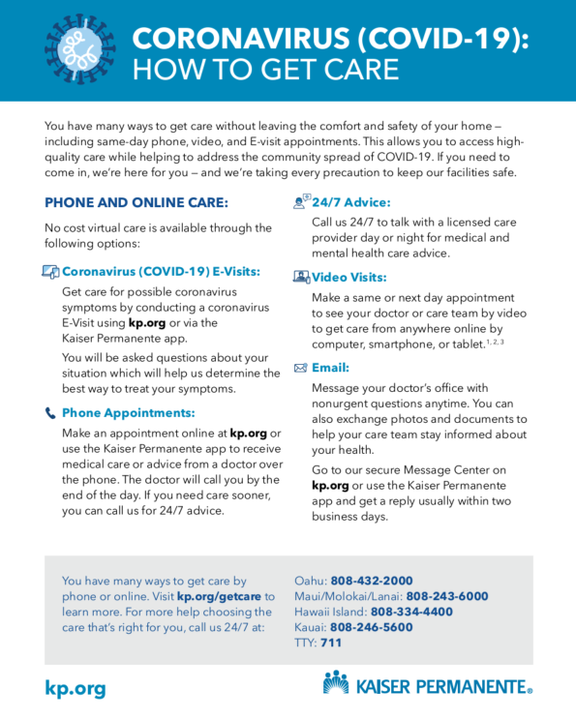
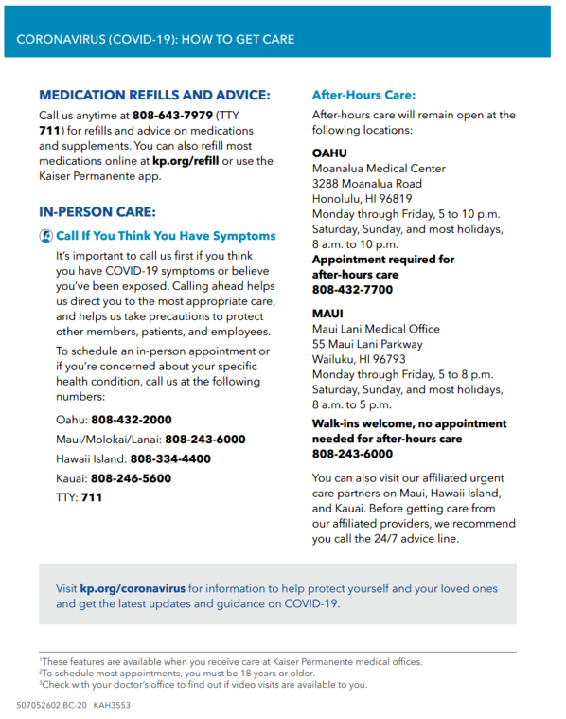
How to get care during COVID-19

Slide 32
Care during COVID-19

Slide 33
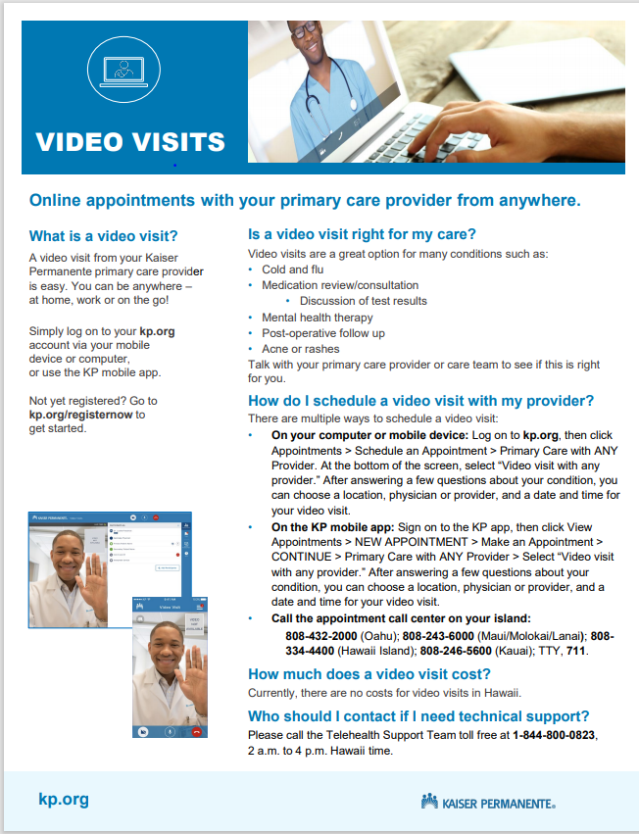
Virtual Visits – Telehealth

Slide 34
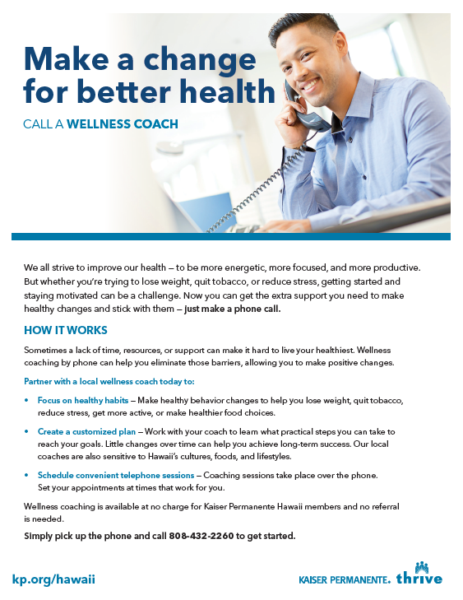
Hawaii Telephonic Wellness Coach
Wellness Coaches partner with members to
Assess members readiness
Focus on healthy habits including weight management, tobacco cessation, stress reduction, getting active, eating healthy
Create a personalized plan
Schedule convenient telephone-based sessions

Slide 35
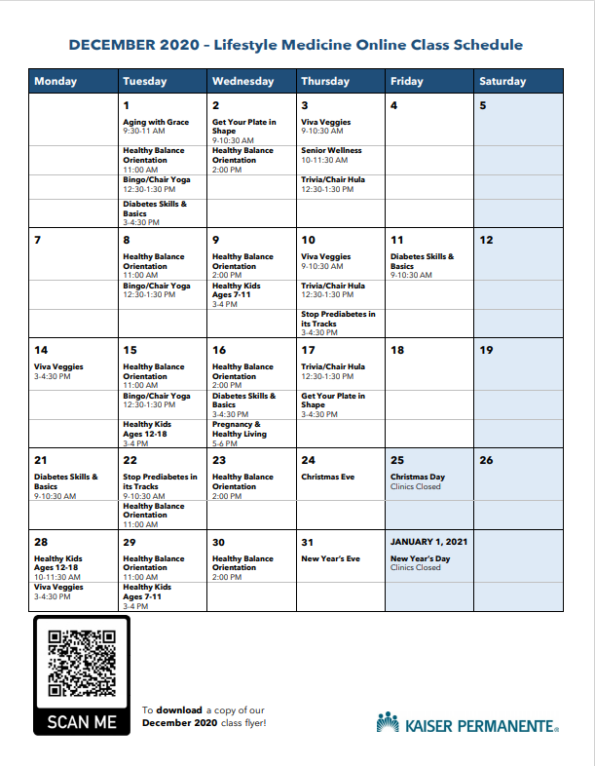
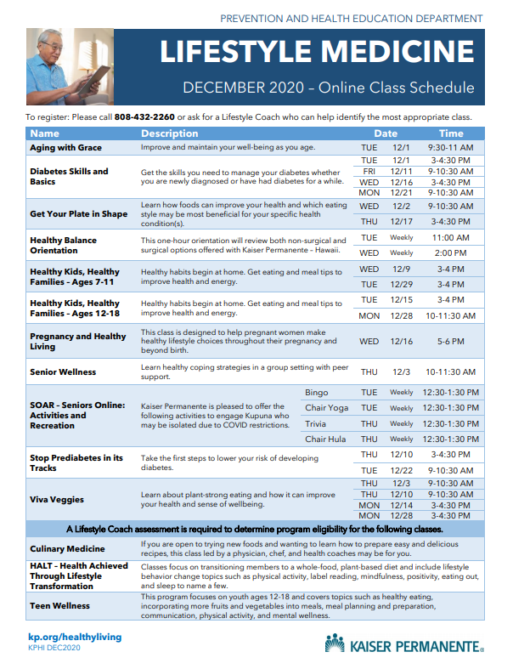
Virtual Classes

Slide 36
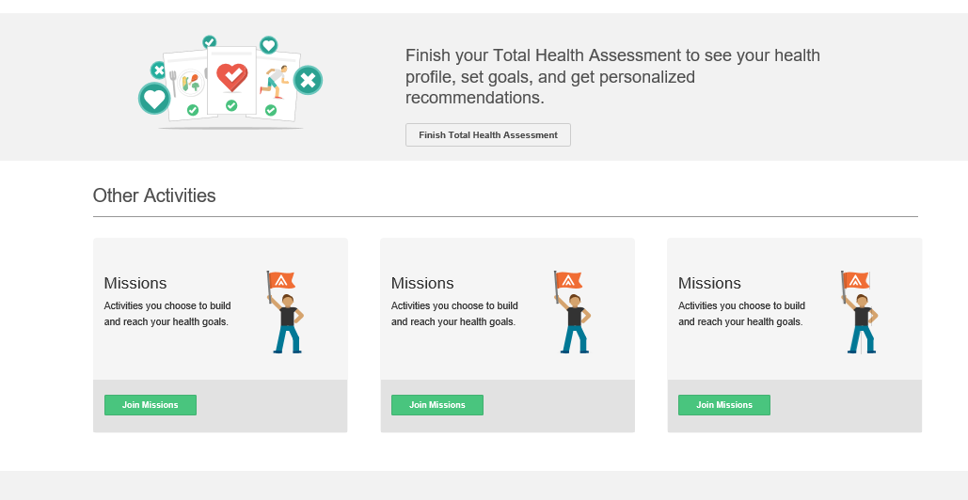
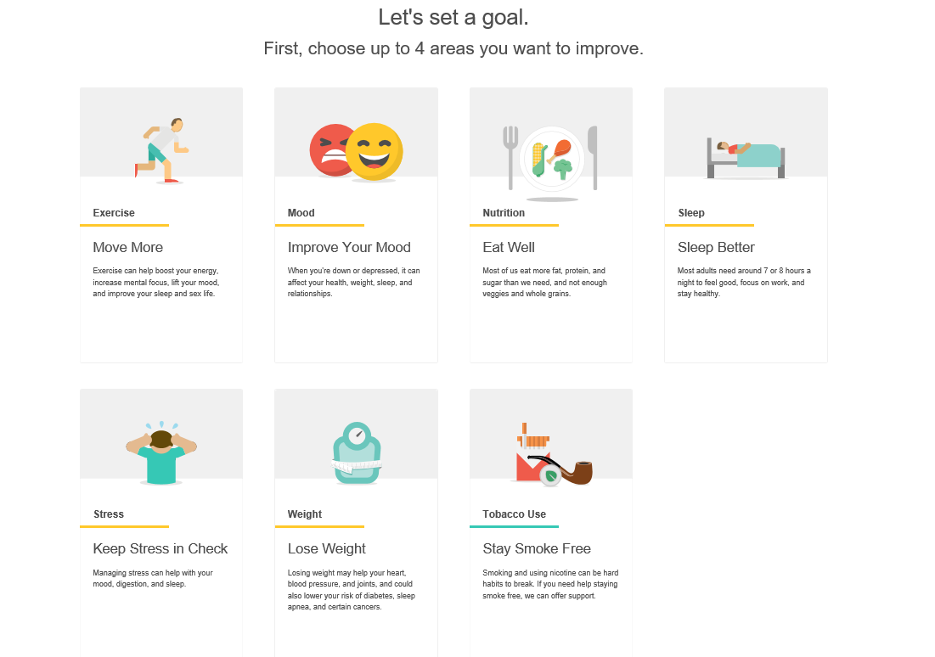
Healthy Lifestyle Programs
Take the total health assessment
Get an action plan
Set goals in healthy behaviors with Healthy lifestyle programs to chose from
Get an action plan
Set goals in healthy behaviors with 15 Healthy lifestyle program topics to chose from.

Slide 37
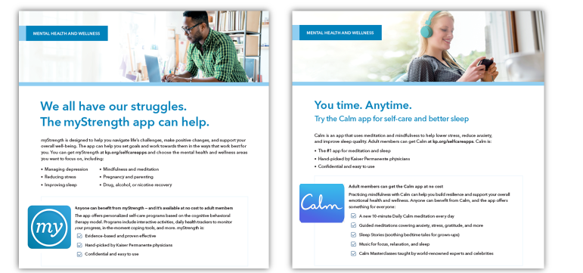
Emotional Wellbeing

Slide 38
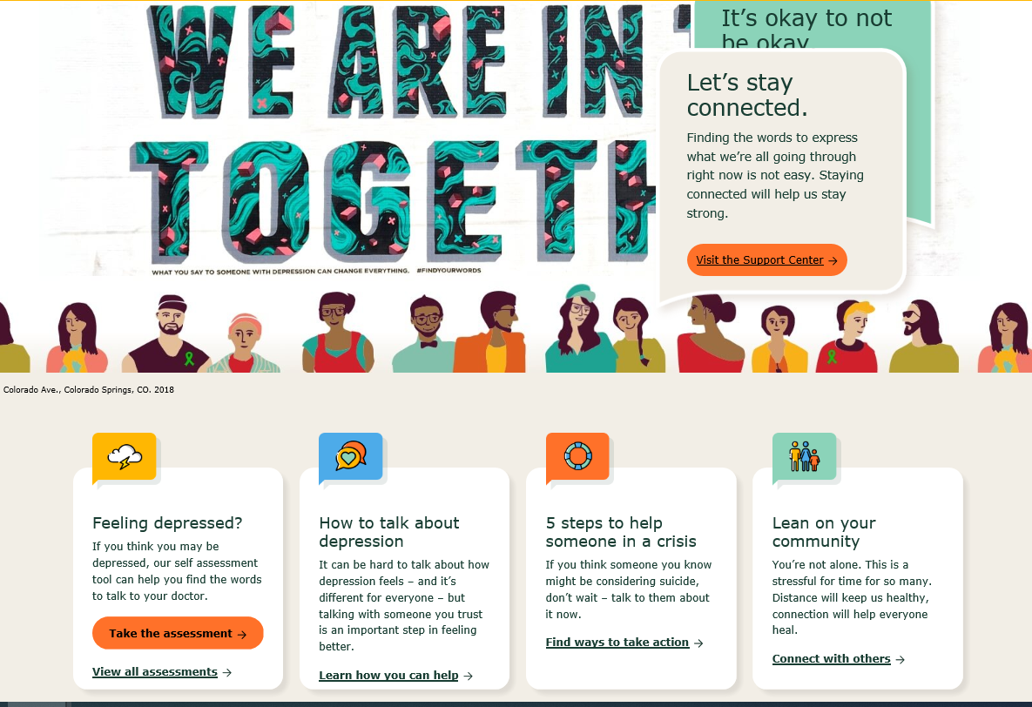
Mental Health & Wellness
Findyourwords.org – Get access to tools and resources on depression.

Slide 39
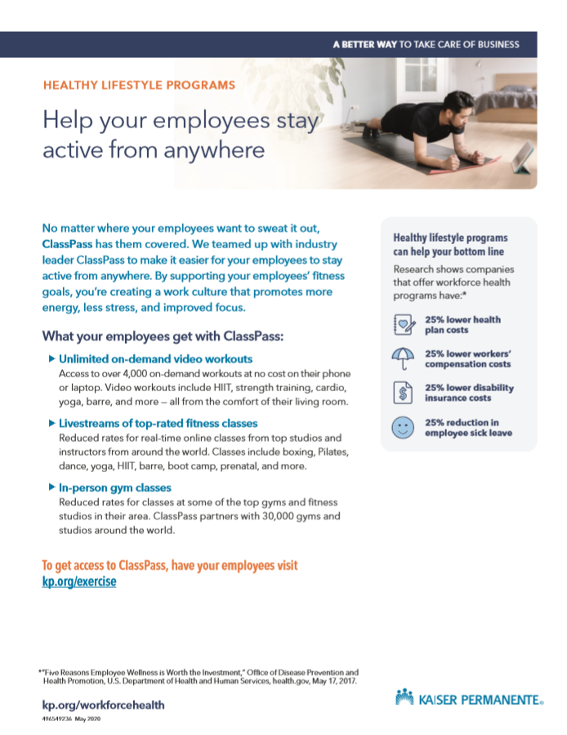
Class Pass
What KP members get with ClassPass:
Unlimited on-demand video workouts
Livestreams of top-rated fitness classes
To gain access to ClassPass, visit kp.org/exercise

Slide 40
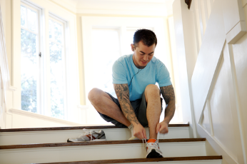
Get Fit, Get Rewarded
You may qualify to earn back the $200 annual program fee (equivalent to a free membership at applicable locations) if you meet the program requirements.¹
If you prefer working out at home, pay just $10 per calendar year and choose up to 2 Home Fitness kits and 1 Stay Fit kit, including the ability to choose a wearable fitness tracker at no additional cost.
New virtual offerings to help you move more and be healthier at home.
Learn more at kp.org/fitrewards.
¹Fitness centers must be qualified fitness organizations operating for the general public. Kaiser Permanente Fit Rewards is administered by American Specialty Health Fitness, Inc. through its Active&Fit® program. Earn your annual $200 program fee back by exercising 45 days a year for at least 30 minutes per session at a participating fitness center. Learn more at kp.org/fitrewards. You are responsible for any taxes that may be due on the amounts received. Please talk to your personal tax adviser for specific tax information about this reward.

Slide 41
Get Fit, Get Rewarded
Get fit and get rewarded
You may qualify to earn back the $200 annual program fee (equivalent to a free membership at applicable locations) if you meet the program requirements.¹
If you prefer working out at home, pay just $10 per calendar year and choose up to 2 Home Fitness kits and 1 Stay Fit kit, including the ability to choose a wearable fitness tracker at no additional cost.
New virtual offerings to help you move more and be healthier at home.
Learn more at kp.org/fitrewards.
¹Fitness centers must be qualified fitness organizations operating for the general public. Kaiser Permanente Fit Rewards is administered by American Specialty Health Fitness, Inc. through its Active&Fit® program. Earn your annual $200 program fee back by exercising 45 days a year for at least 30 minutes per session at a participating fitness center. Learn more at kp.org/fitrewards.
You are responsible for any taxes that may be due on the amounts received. Please talk to your personal tax adviser for specific tax information about this reward.
Notes:
Kandace

